Slide 1

Student name: A.ADLIN DAFNE Register No: 312210278 NM ID:548318B73416BD09A9445188EB4B6A30 Department: commerce Collage: GURU SHREE SHANTIVIJAI JAIN COLLEGE FOR WOMEN
EMPLOYEE DATA ANALYSIS USING EXCEL

Slide 2
Project title
Employee Performance Analysis Using Excel

Slide 3
AGENDA
Problem Statement
Project Overview
End Users
Our Solution and Proposition
Dataset Description
Modelling
Results and Discussion
Conclusion

Slide 4
Problem Statement
"As a human resources manager, I want to improve employee retention, productivity, and overall organizational performance. To achieve this, I need to analyze our employee data to identify trends, patterns, and correlations that inform data-driven decisions.

Slide 5
Project Overview
Improve employee retention, productivity, and overall organizational performance by analyzing employee data to identify trends, patterns, and correlations that inform data-driven decisions.

Slide 6
Who are the End users
Employee data analytics

Slide 7
Our Solotion and its Value Proposition
Conditional formatting – missing
Filter – remove
Formula – performance
Pivot – summary
Graph – data visualization

Slide 8
Dataset Description
Employee=- Kaggle
26 – features
9 – features
Emp id – num
Name – text
Emp type
Performance level
Gender-male female

Slide 9
The Wow in Our Solution
Performance level =Ifs(Z8>=5,"VERY HIGH",Z8>=4,"HIGH",Z8>=3,"MED",TRUE,"LOW"

Slide 10
MODELLING
Modelling for Employee Data Analysis involves using statistical and machine learning techniques to identify relationships and patterns in the data.

Slide 11
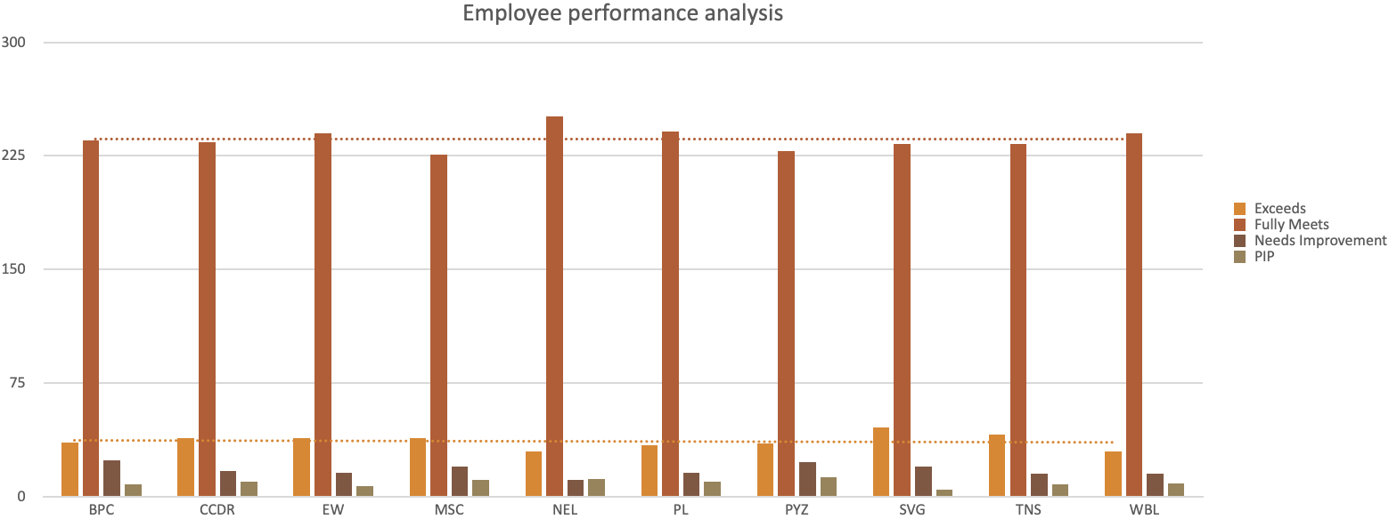
RESULTS

Slide 12
CONCLUSION
The Employee Data Analysis project aimed to improve employee retention, productivity, and organisational performance through data-driven insights. By leveraging statistical and machine learning techniques.

